Slide 1
Talk 36: Camelot The Kennedy Years 1960-1963
Kennedy family
The Rise to power
Limits of Office
Crisis and Recovery
Assassination and legacy

Slide 2
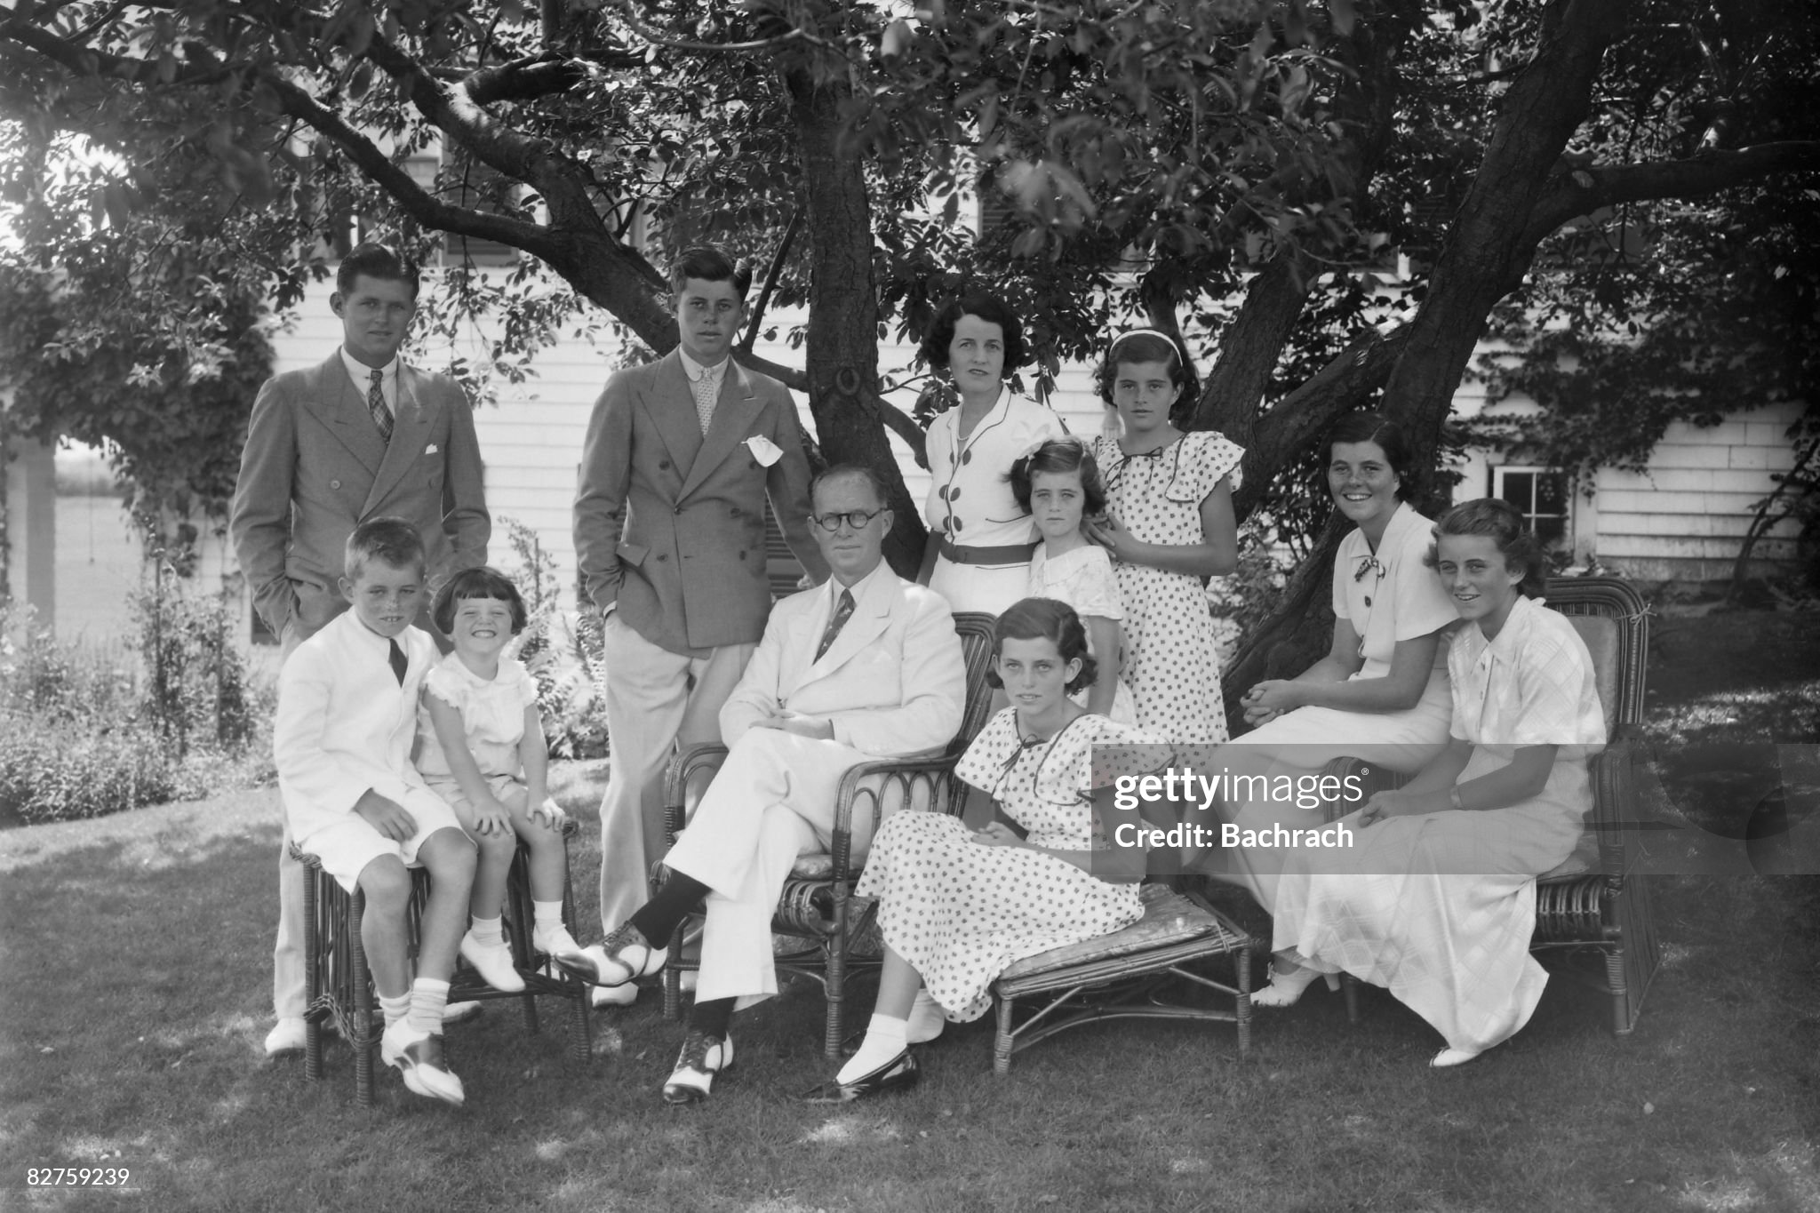
Joe JR
JOHN
Rose
Kathleen
(Kick)
Joe
Rosemary

Slide 3
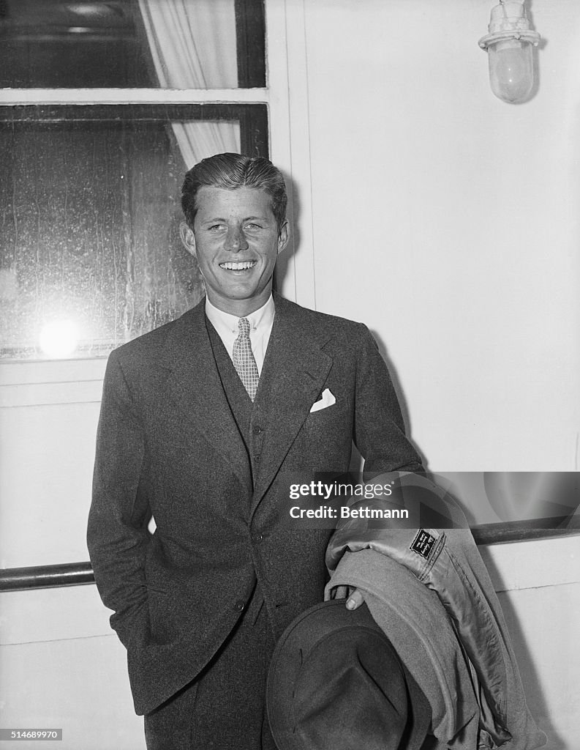
John Kennedy (1917-1963)
……Invalid….2nd son.
Scarlett fever…nearly dies
Spastic colitis…indigestive
Urinary tract, duodenal ulcer
….side-lined by father
John Kennedy 1938 (aged 21)
Adores older brother
Competitive. Football injury
Spinal injury…back brace
Harvard…..political science
joins father UK 1938
….Tours Europe 1938/39.hates Nazis
… returns to US..US/UK alliance vs Germany
…”Why England Slept”
Enrols Harvard Law school.
.wants to join Navy 1941 ..fails medical
…Joe Sr secures exemption
….Seeks most dangerous job….
…father arranges captain PT Boats

Slide 4
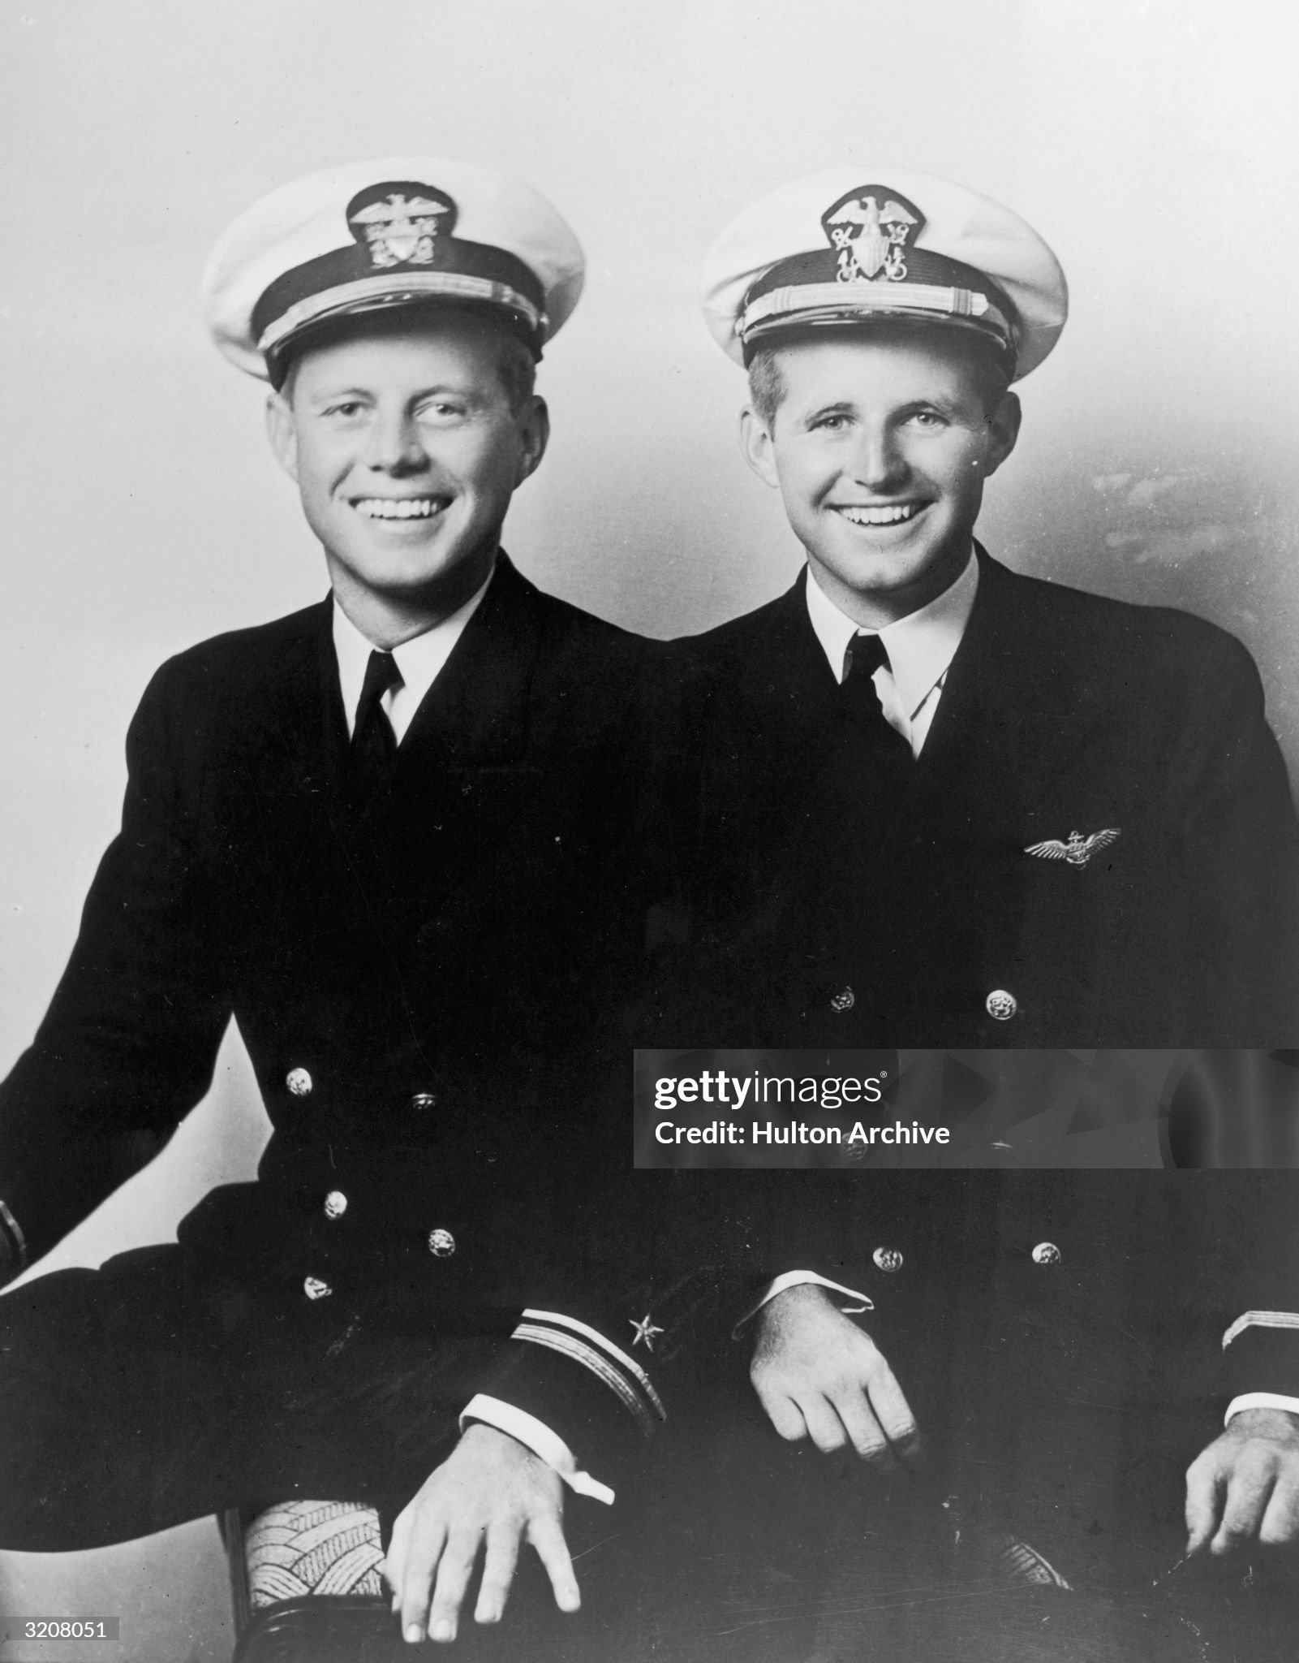
Joe and Jack….ready to go to war

Slide 5
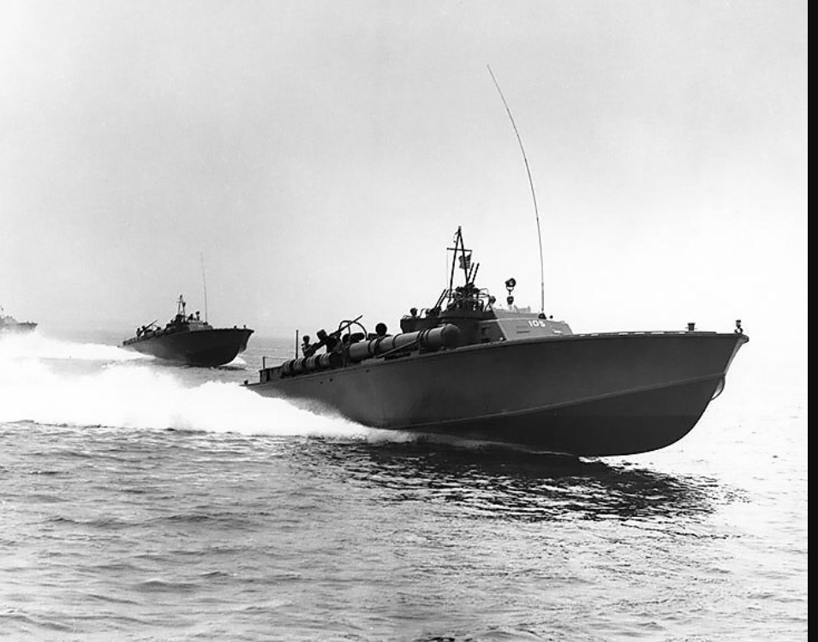
PT Boats…fast, lightly armed, Pacific war….supply, intercept transports, raids

Slide 6
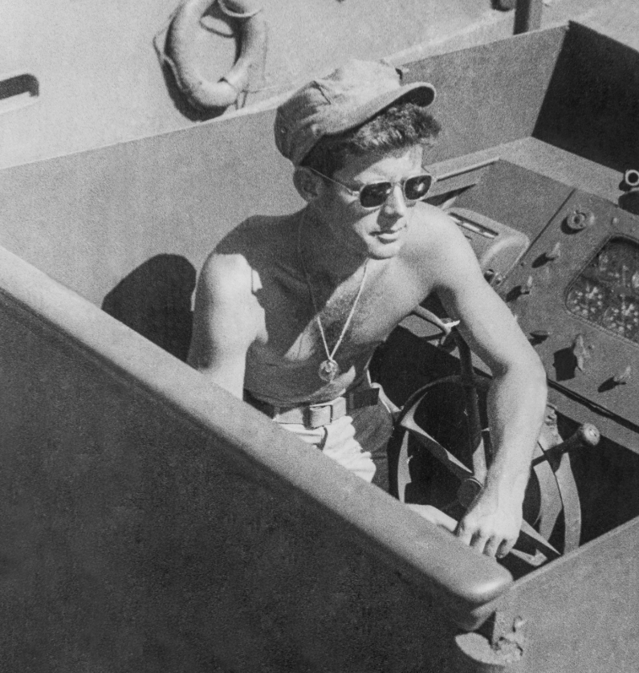
Lieutenant Kennedy…Pt 109 July 1943

Slide 7
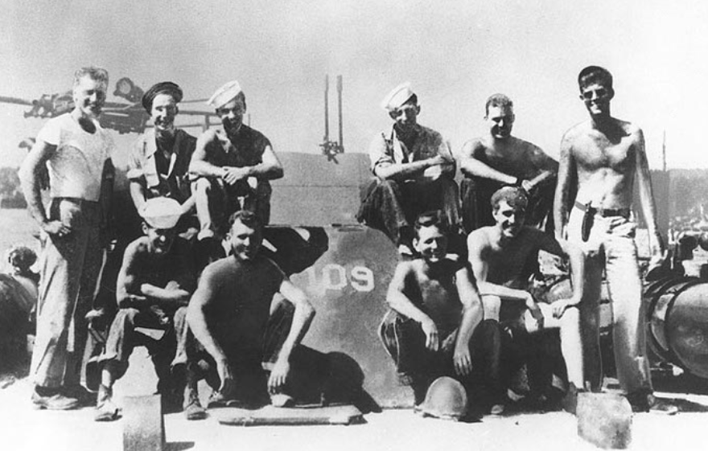
Kennedy and crew..August 1943

Slide 8
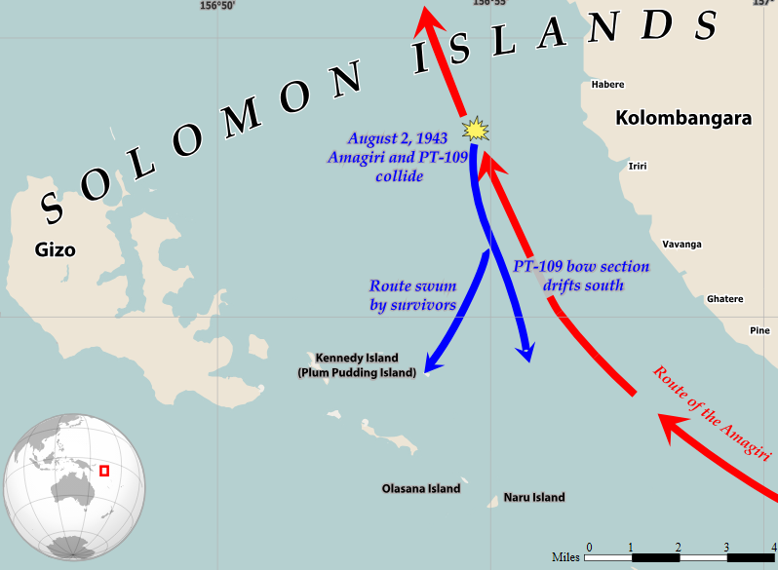
Battle of Bassets Island
15 PT boats sent to
Intercept Japanese resupply
Including PT 109
1
Attack fails…torpedoes miss
..Pt109 + 3 do not fire
…wait for destroyer to return
..fog….Destroy rams Pt100
2 crew killed, PT109 sunk
1
2
Kennedy swims with survivors
5 miles to “Plum Island
Swims to surrounding island
….coco nut shells
…found by natives
,,,rescued by NZ navy

Slide 9
JFK War Hero
Post rescue publicity
Joe Snr ensures story in US newspapers
Back injuries…one month recuperation….refuses to leave
Return to service
3 months action
Invalided out December 1944
Return to US
Contact Joe JR: response/ pride….competition
Joe Jr….suicide mission ……drone operation…..bail out
Joe Jr Killed August 1944
Kate husband Duke of Cavendish killed Belgium 1944 …affair Lord Fitzilliam…plane crash 1948)
Joe Kennedy Snr…..John replaces Joe as “first Catholic President”

Slide 10
Kennedy the Congressman
“Congressman”: member House of representative or Senator
Representative
1 Representative per “Districts”
US divided into 435 .allocated by state based on population
2 year term/ Constant re-election/ Local issues/ power of incumbency
Senator
2 Senators per state
50 Senators….regardless of population
6 year term…National/ International issues
Job #1 for JFK …..become Representative for Massachusetts

Slide 11
Rise to Power

Slide 12
Kennedy the Representative 1947-1953
Winning election
Massachusetts a “safe” Democrat seat
Joe Snr “persuaded Rep to vacate…major of Boston
Joe floods market with advertisements, radio broadcasts
Easy win….42% Democrat vote (9 candidates)
Performand
Highest level of absenteeism….illnesses / Indifference to constituents
Support McCarthy…anti communist
Supports NATO, Marshall Plan, opposes restriction on unions
Joe Snr…next step Governor, JFK refuses ….“boring..all they do is approve sewers”
..….future is to run for Senate….needs a wife

Slide 13
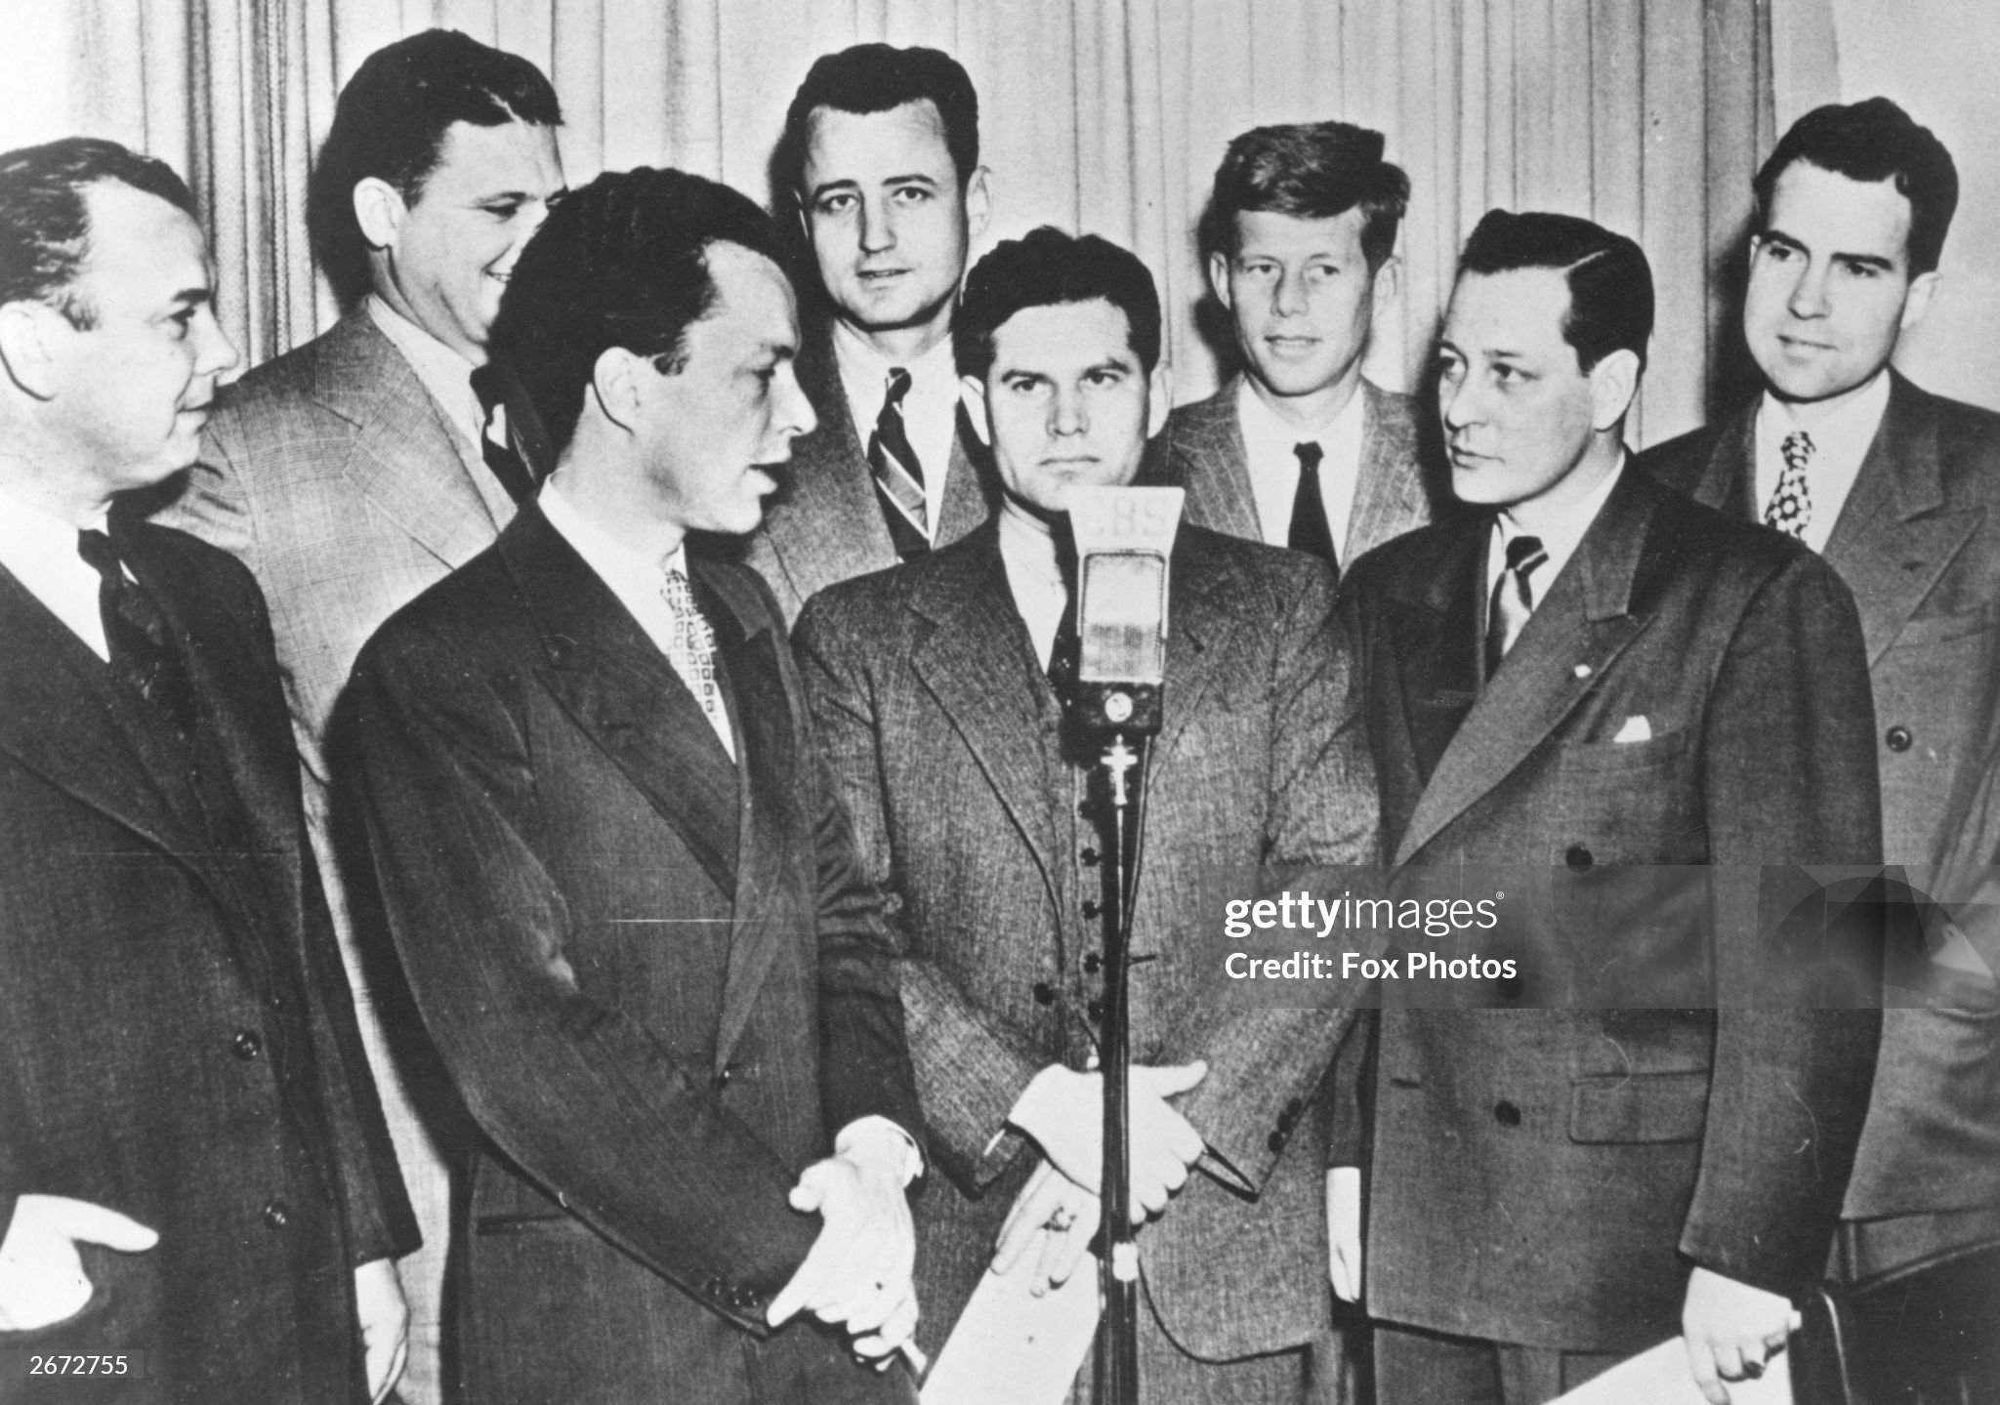
The new Congressman 1948
John Kennedy
Richard Nixon

Slide 14
Jackie Bouvier..Kennedy..Onassis (1929-1994)
Wealthy family
Father stock broker…”Black Jack” Bouvier
Mother…socialite Janet Lee..real estate father
Jackie 1963
Jackie: Private education….equestrian, languages
…fluent French, Italian, Spanish..ballet dancer
…devout Catholic
Parents divorce….father nearly wiped out by
Crash…alcoholic…womanizer…
Jackie…profound shock…turned in on herself
Mother remarries…elite Protestant family
….sense of being outsider
…boarding school 1940-1944: famous fo“"her wit, her
accomplishment as a horsewoman , and her
unwillingness to become a housewife"
Graduates Vassar College….journalist for Vogue
Magazine..street interviews
Late 40’s…on the hunt for provider…meets JFK at
Party…”attracted to wealth, looks, and wit”

Slide 15
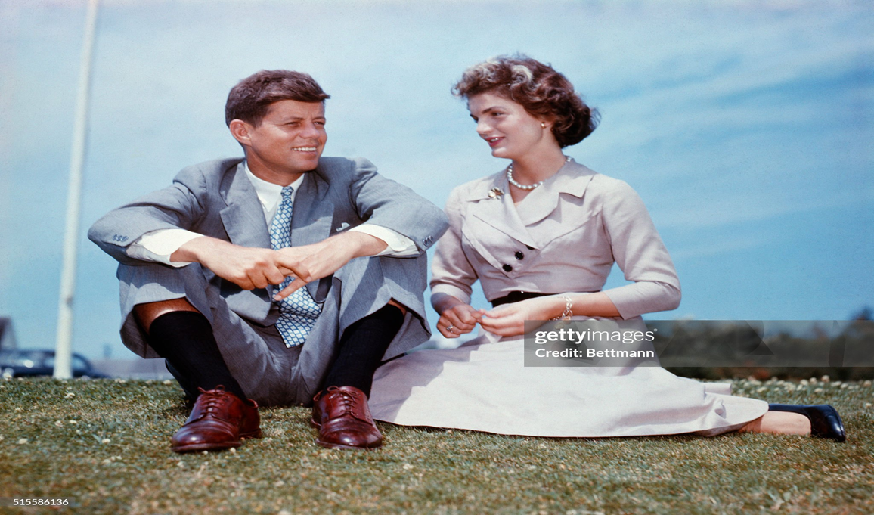

Slide 16
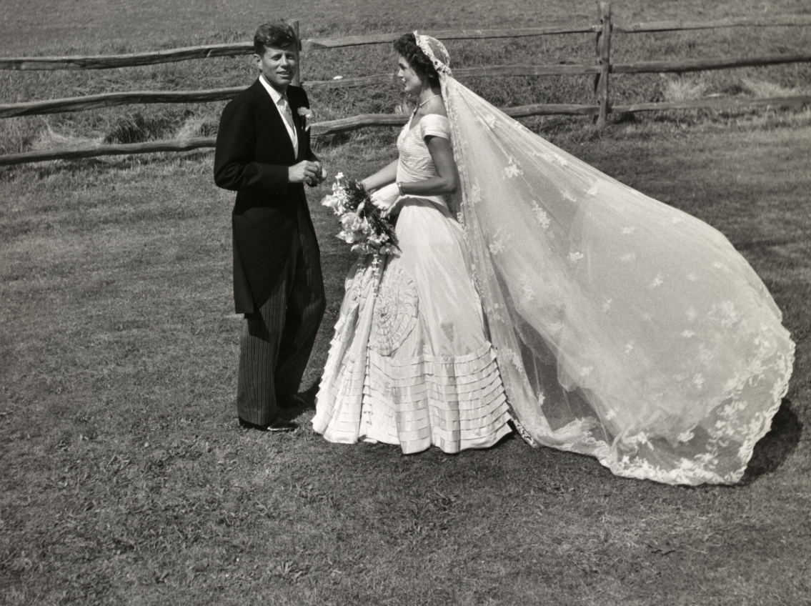

Slide 17
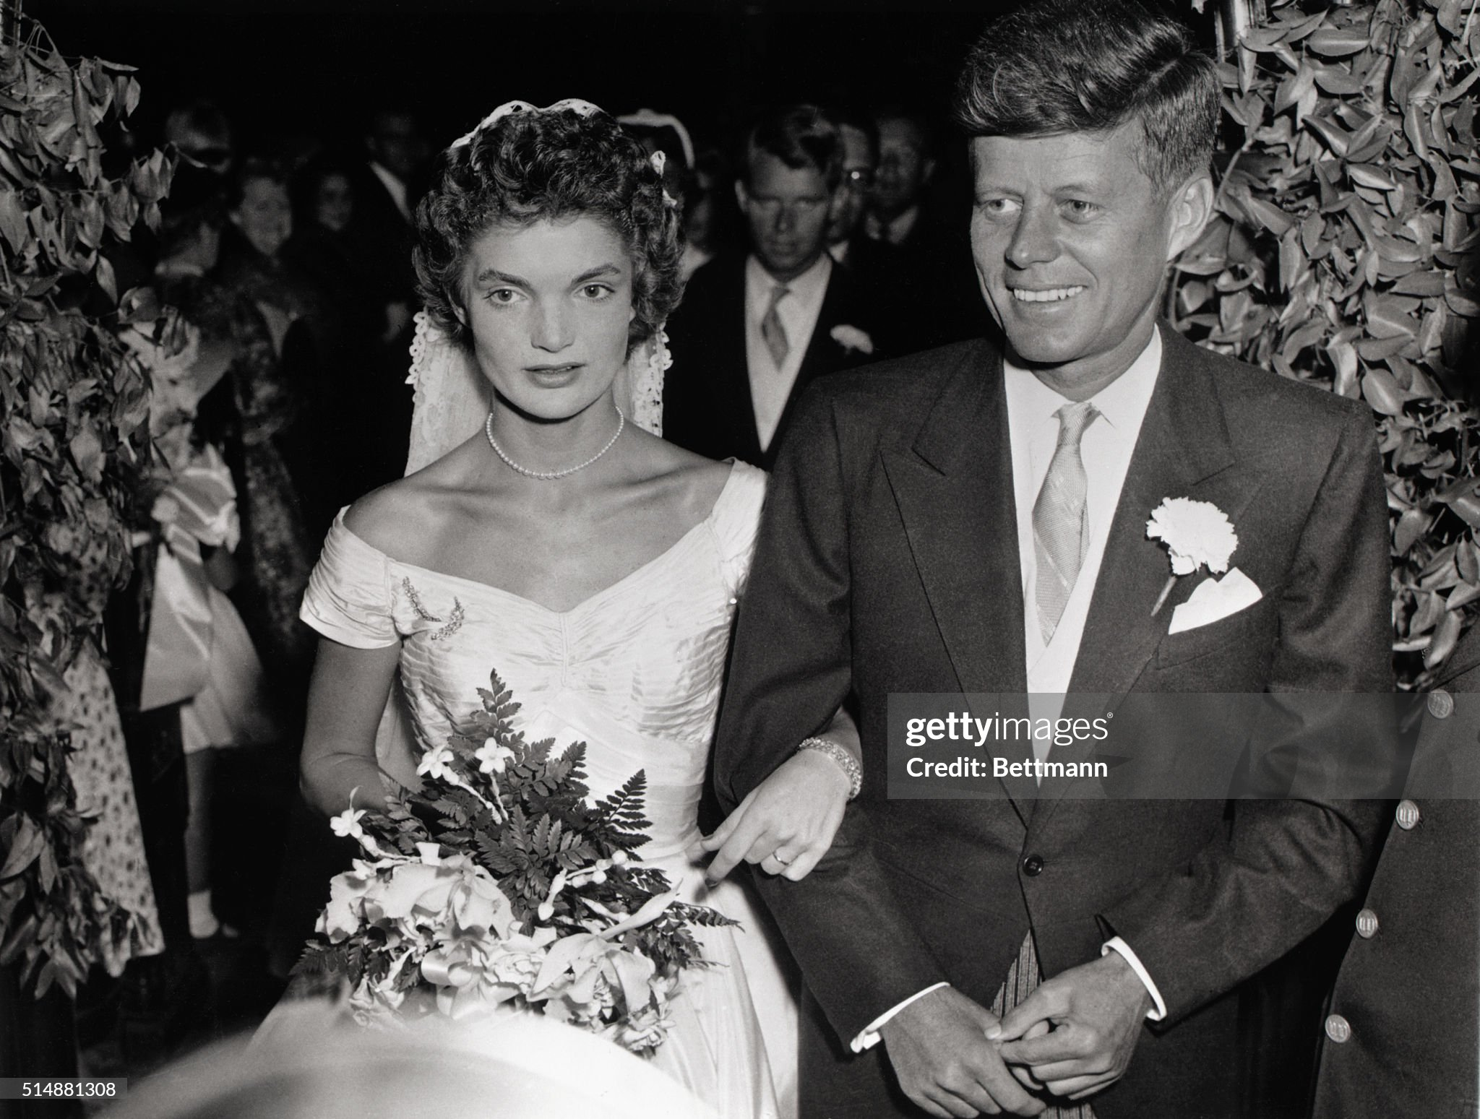

Slide 18
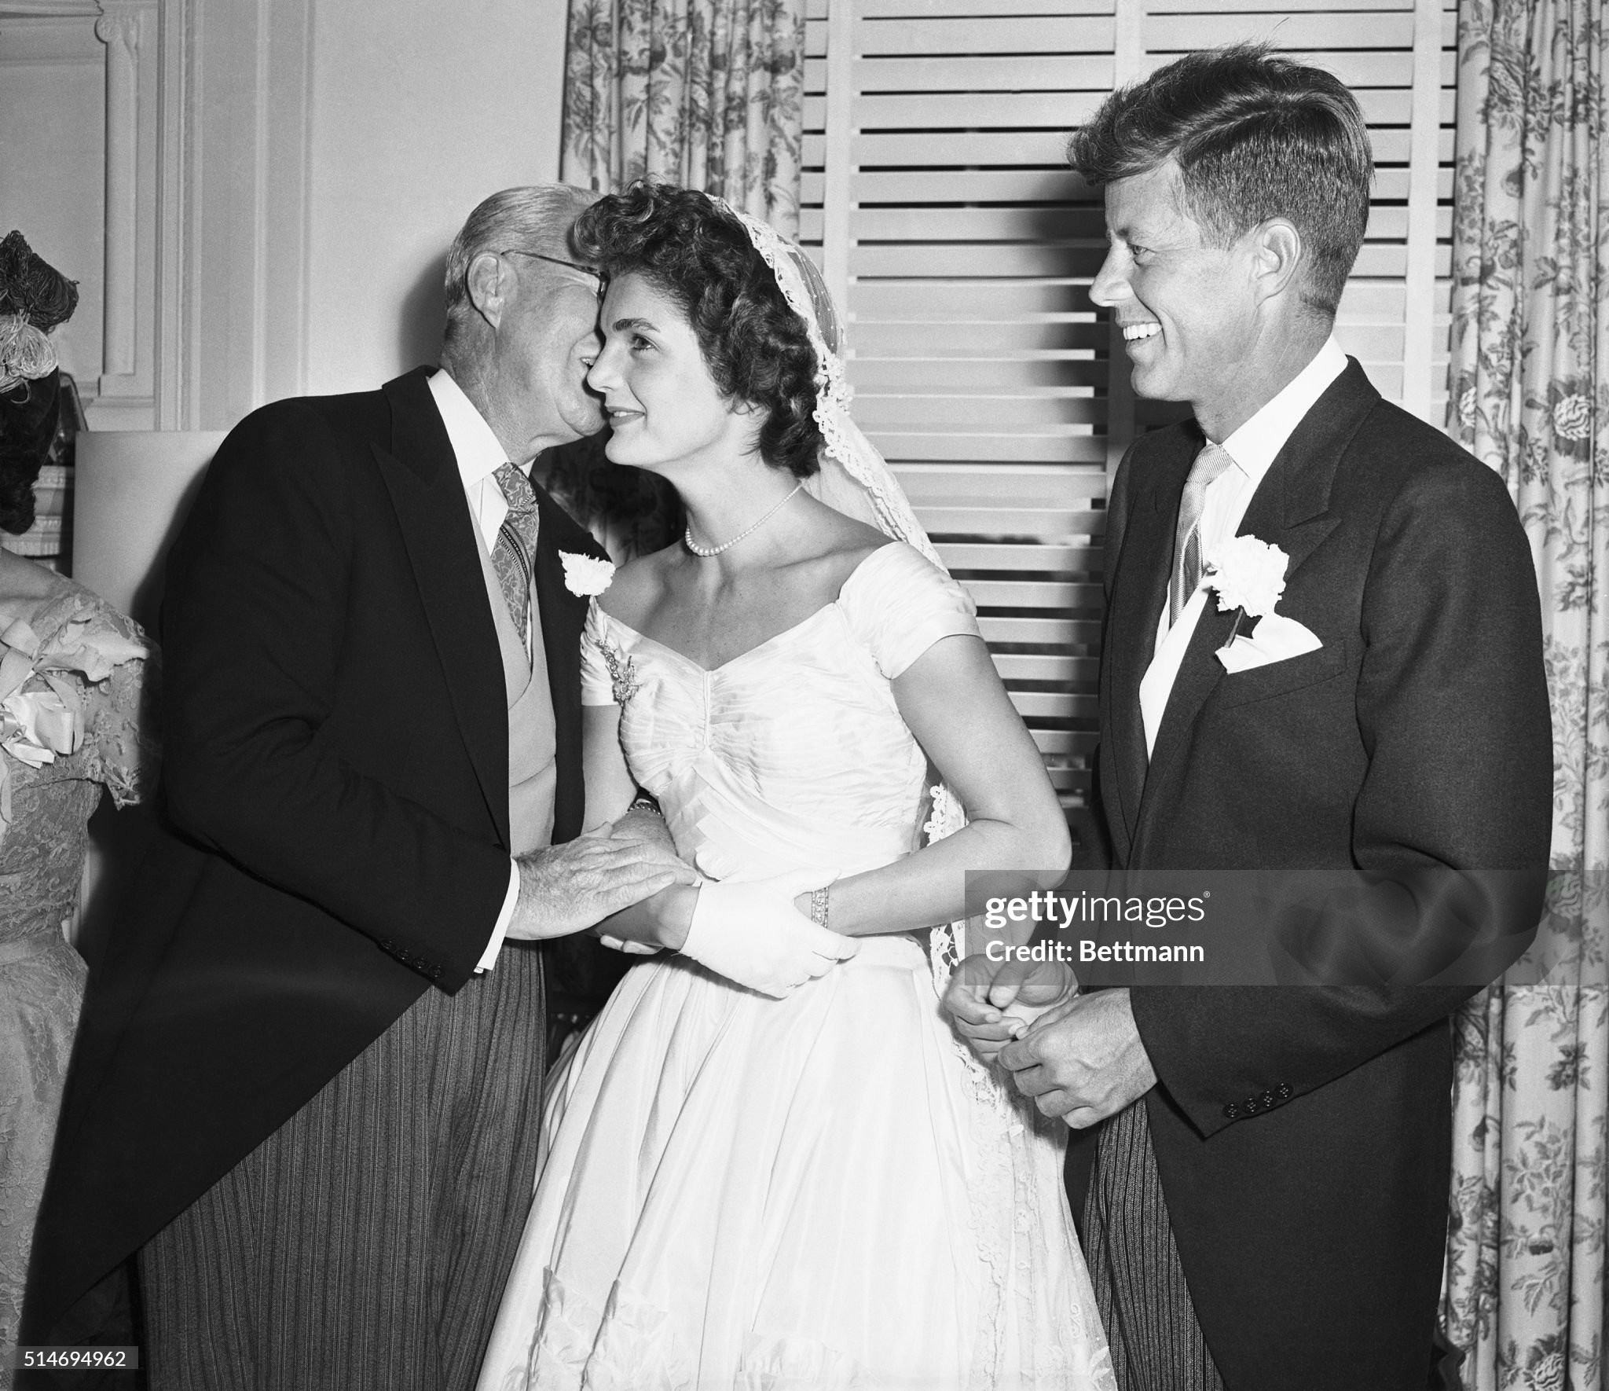

Slide 19
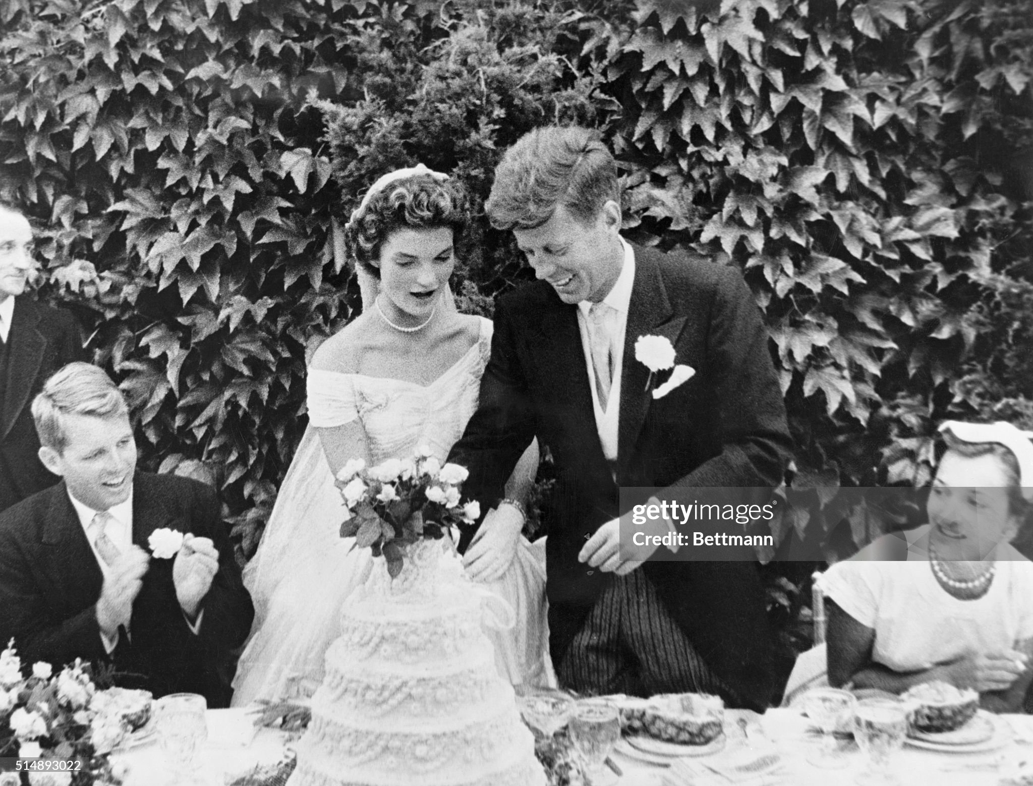
Bobby Kennedy

Slide 20
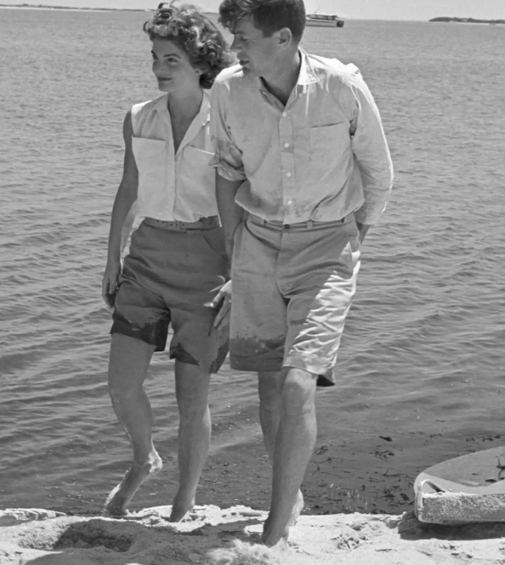
A partnership in power

Slide 21
The Kennedy Marriage: women
Jack Kennedy and women
“I need a new woman every 3 days or I get a headache” (Harold McMillian UK PM 1956-1964)
Relationships brief…emotionless
Immitating father/ compensate for illness? Expecred early death
“..being married didn’t really mean you had to be faithful to your wife”
On coed yacht trip in Medittaranean Jackie’s first pregnancy 1956 ….miscarriage…reluctant to leave “You better get your ass ack to your wife if you want to be a Senator”.
Jackie reaction
“She was not prepared for the humiliation she would suffer when she found herself stranded at parties
While Jack would suddenly disappear with some pretty girl.”
He's like my father in a way — loves the chase and is bored with the conquest — and once married, needs proof he's still attractive, so flirts with other women and resents you. I saw how that nearly killed Mummy,"/
“I don’t think there are many men faithful to their wives. Men are such a combination of good and evil”

Slide 22
The Kennedy Marriage:
John and Jackie relationship
kindred spirits”…Jackie need for wealth & status, John family, identity
"It was a marriage of its time. "It was kinetic between them. She wasn't trying to change him.“(close friend…People Magazine
Discretion…most of the time….Press respectful, non intrusive
John health issues
Continuous back pain, urinary..fear of becoming invalid and unable to walk
Surgery 1956….major surgery …..50% chance of survival given “last rites”
Kennedy& Children
First healthy child Caroline 1958
John Kennedy…smitten….adoring father
Jackie…confidante and protector….projects health of husband

Slide 23
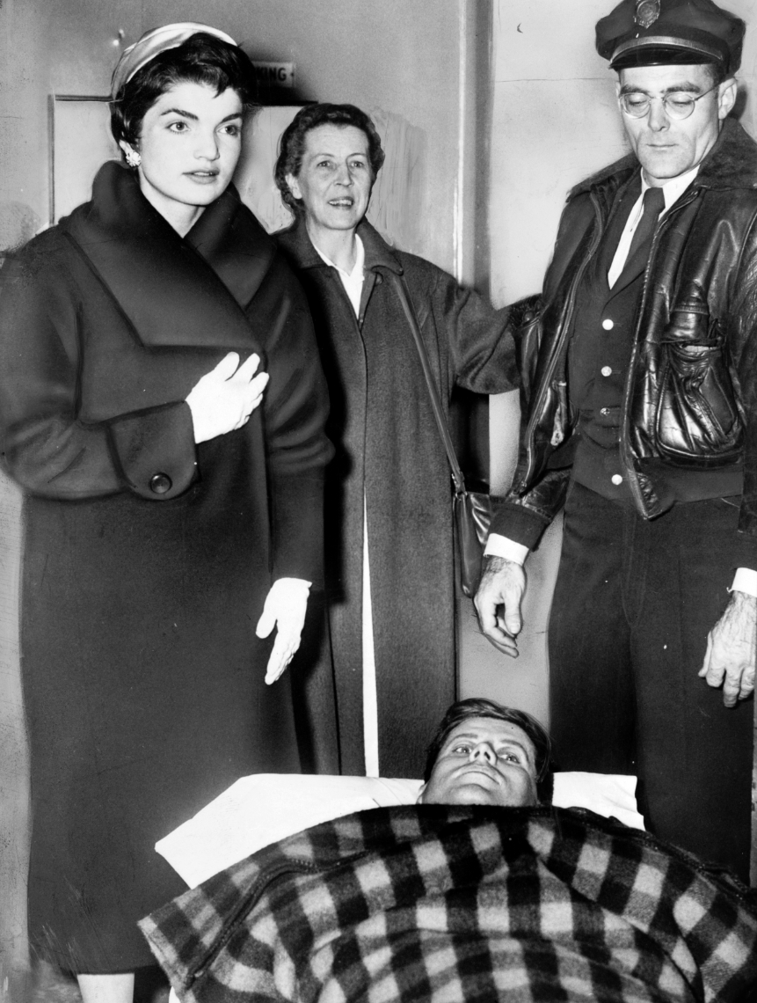
Recovering from back surgery 1954

Slide 24
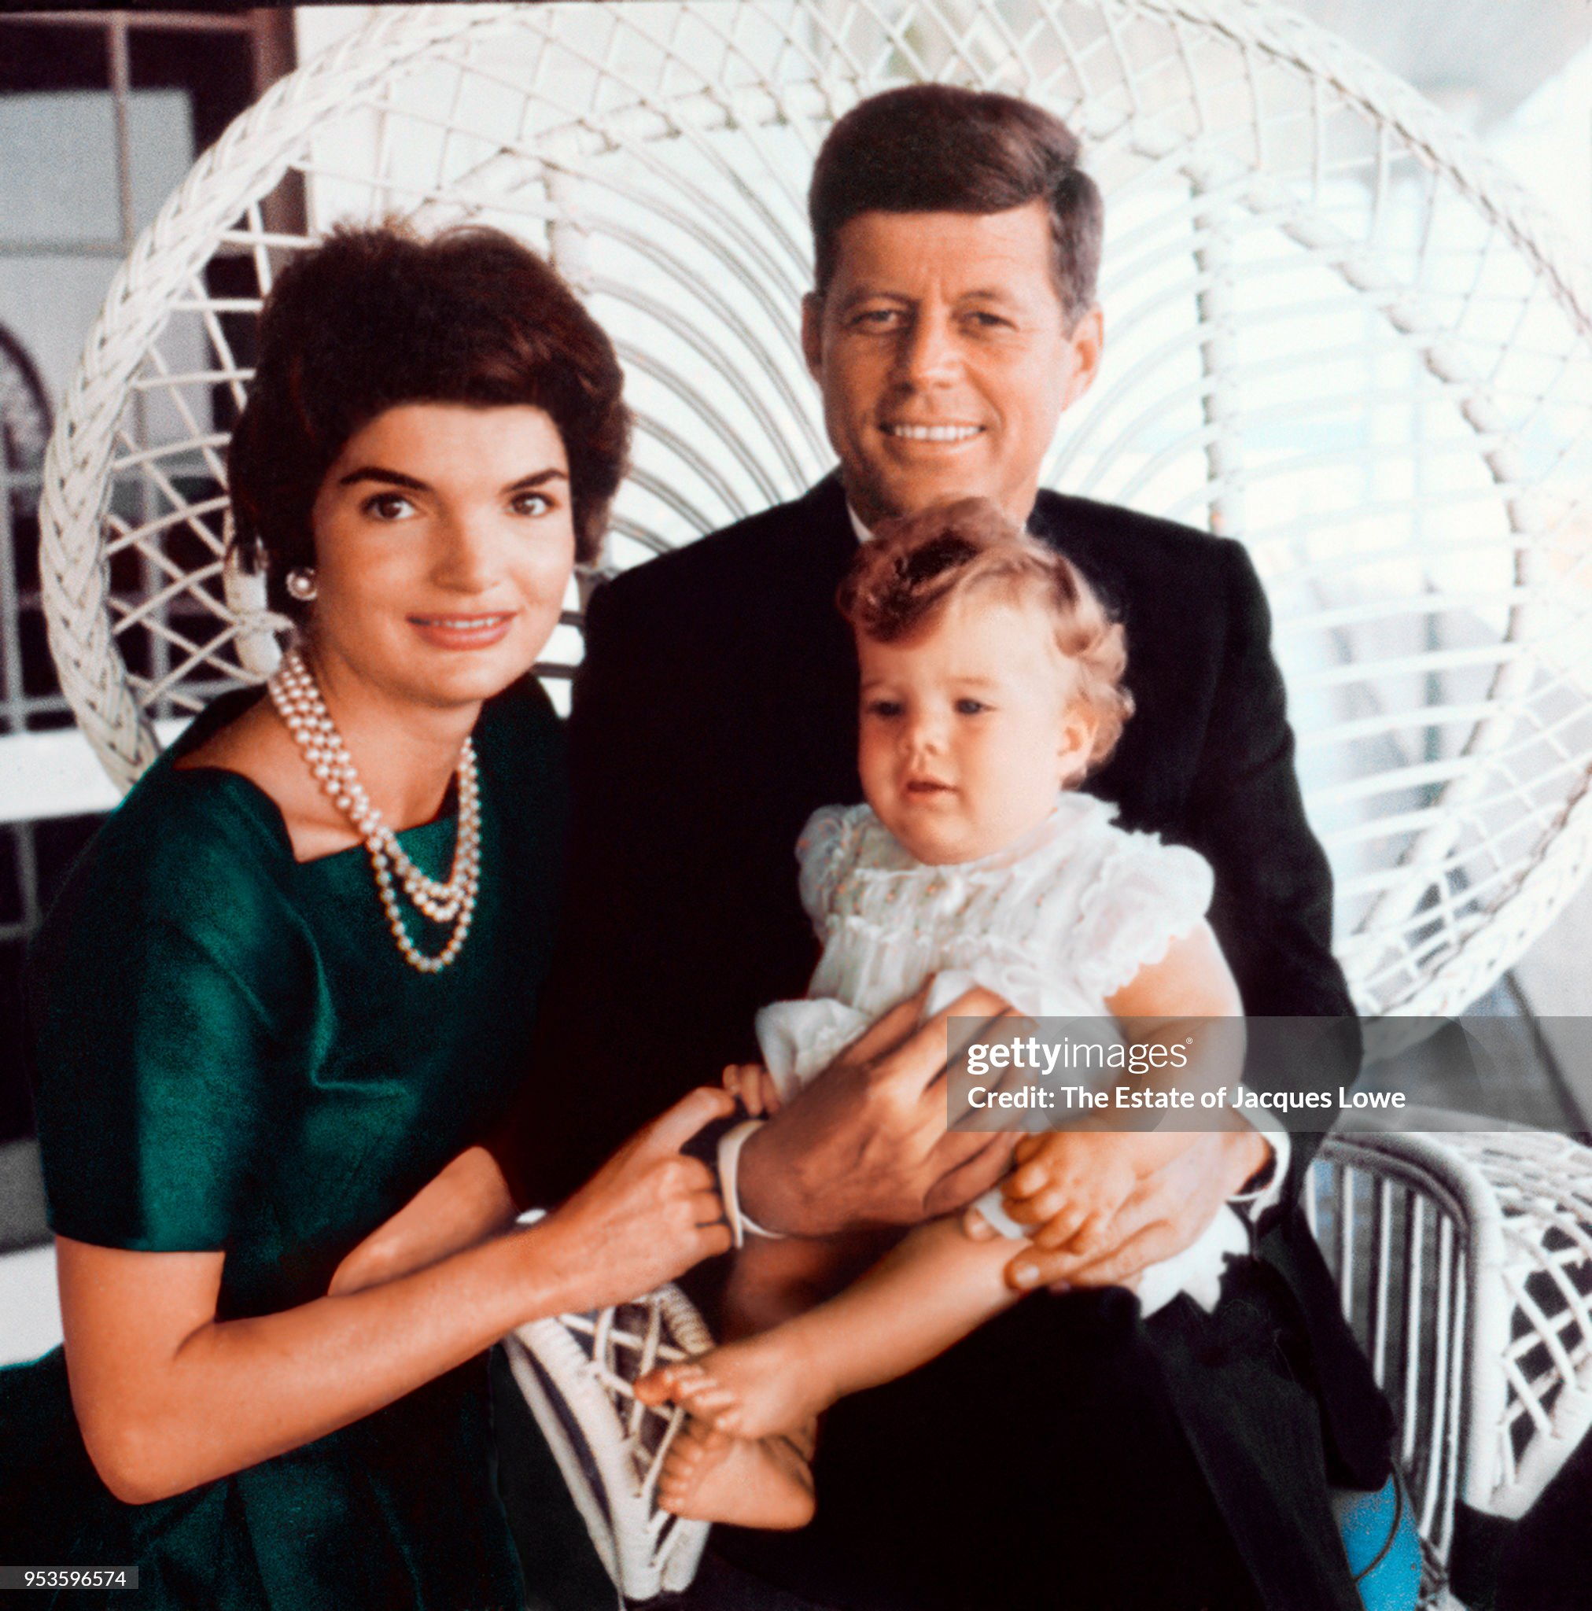
The public image….young Senator & family 1953
John needed someone else to move him forward…someone loyal, intelligent…absolutely fanatical

Slide 25
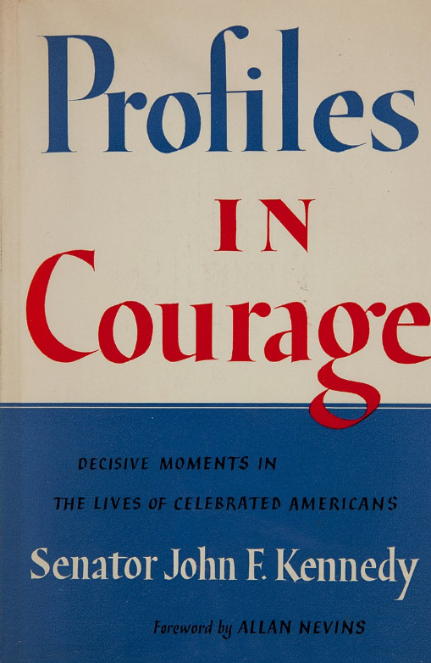
Profiles in Courage
Released from hospital
….”ghostwritten”?
Lives of 8 Senators
…all opposed popular
view

Slide 26
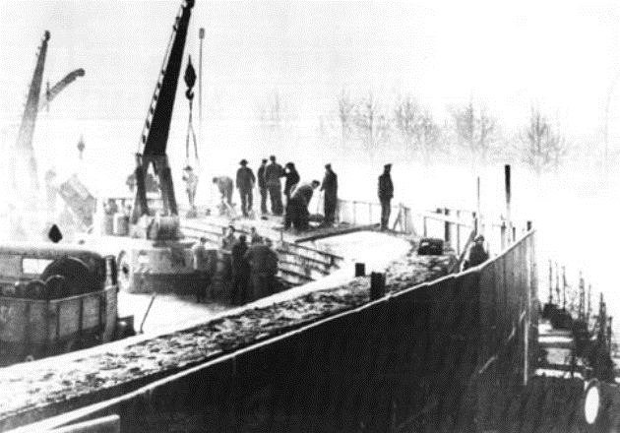
Construction of Berlin Wall
Stand off in Berlin
…tank to tank
Krushchev decides to
Seal off West Berlin
….wall built across/ around city
Escapees shot
…”world outrage”
Kennedy “ a wall is a hell of
A lot better than a wall”
Meanwhile…in Cuba
US “invasion” goes ahead

Slide 27
The Crisis
October 14……US photographs missiles…meet to form response
..attack missiles
…invade Cuba
….”Quarantine”
October 22nd.../JFK addresses the nation…
October 26th….1st letter from Krushchev….will withdraw….US to remove missiles Turkey and Italy
October 27th …2nd letter…rejecting first

